Slide 1
Services & Outcomes (Action Plan) in CMS
MOC Inc

Slide 2
Agenda
Action Plan Screen
Adding a One-Time Service
Completing a One-Time Service
Adding a Regular Service
Exiting a Regular Service
Completing a Regular Service
Service Maintenance
Program Enrollment vs Service Delivery

Slide 3
Action Plan Screen

Slide 4
Action Plan Screen
The Action Plan contains information relating to a client’s services and outcomes. The purpose of an Action Plan is to help efficiently track services and their progress for each service. The table displays the following information about each service:
Service- Name of service and service variant (if applicable)
Program- Name of program for which service was completed
All services are required to have a program
Service Owner- The case manager who is currently working on the service
Service Status - The current status of the Service
Service Start Date- The service start date is the date the service has “started”
Service Completion Date
If service is still progressing, the target service completion date will show. If showing a target service completion date, the field will be bold and italicized.
Service Outcome Status
Progressing: Selected/target outcomes are still progressing
Completed: All selected/target outcomes have been completed
None: No outcomes have been selected
Action
View
Edit
Delete

Slide 5
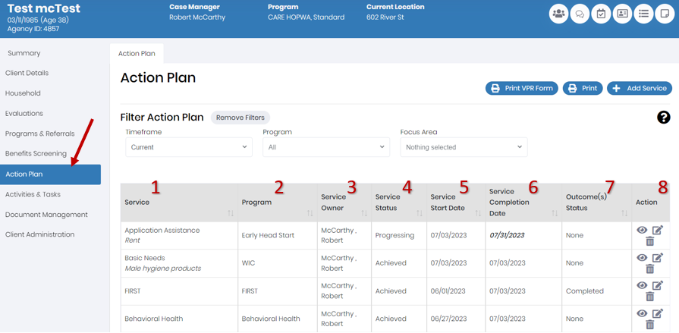

Slide 6
Action Plan Screen
From the main Action Plan Screen you can:
Print the Action Plan
Filter the Action Plan
Timeframe
The default timeframe filter is "Current" which shows the client's currently progressing services. To show all services change the timeframe filter to "Historical"
Program
Focus Area
Can link a service to a focus area when adding a service
Add a Service
Edit/View a Service

Slide 7
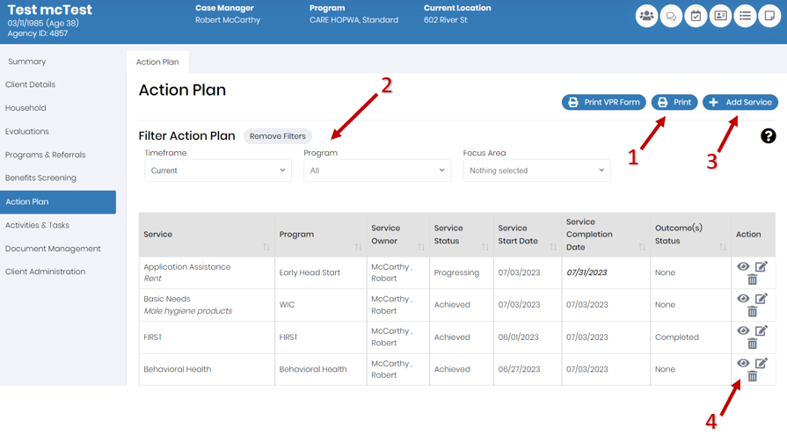

Slide 8
Adding a Service

Slide 9
Adding a Service
When you click to add a new service, the service selection screen will appear with the following fields:
Service Owner
Will default to the user adding the service
Service
Service Variant (when applicable)
Program
Program Variant (when applicable)
Note: Once these fields have been selected, you will need to press “Restart” in order to change the service that you have selected
The required Service Details depends on if the service is a One-Time Service or Regular Service
It is recommended to always select “Program” prior to selecting “Service” so you only see the correct services available for the Program you are adding the Service for.

Slide 10
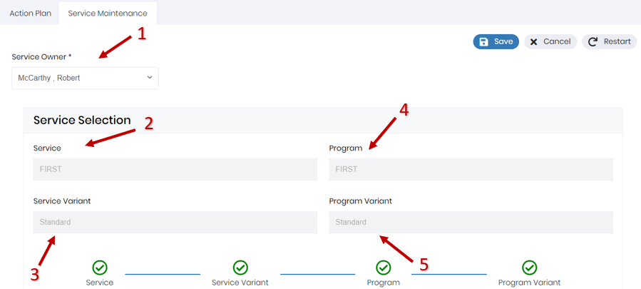

Slide 11
One-Time Service
A One Time Service is a service that is automatically completed when it is delivered. An example of a One-Time service is CARE Assessment
Adding a One Time Service
To set up a one-time service, only a service date is needed
Service date will be defaulted to current date
Completing a One Time Service
For a one-time service, all achieved outcomes should be selected before saving the service.
In order to indicate outcomes that have been achieved, the box next to the relevant potential outcomes should be checked
The status of the outcome will automatically be dated and set to a status of “Achieved”

Slide 12
Regular Service
A Regular Service is a service that requires follow up before the service and/or outcome can be completed. An example of a regular service is Behavioral Health
Regular Services have 3 potential Service Status:
Progressing Service:
indicates the customer is actively moving towards completing the service being provided. This will be the default value when adding a service.
Achieved Service:
An achieved service indicates the customer has successfully completed the service being provided.
When this status is selected, the “Actual Service Completion Date” will appear and be required. This will default to the current date.
Exited Service:
An exited service indicates the customer has not and will not complete the service being provided.
When this status is selected, the “Actual Service Completion Date” will appear and be required. This will default to the current date.

Slide 13
Adding a Regular Service

Slide 14
Adding a Regular Service
When setting up a regular service, you must select:
Service Start Date
Service Start Date will be defaulted to current date
Service Status
Target Service Completion Date
The system will generate a task for the service owner with the target service as a due date
This date can be edited at a later period
Focus Areas
Focus Areas can be used as tags for the service to filter by in the Action Plan
Multiple Focus Areas can be applied from the drop down
You may also select any potential outcomes that you will be working towards by starting this service by changing the status of the relevant outcome to “Progressing”
Once selecting this status, you may select a Target Completion Date for the outcome
Note: This step is not required, you may leave all outcomes blank (the default)

Slide 15
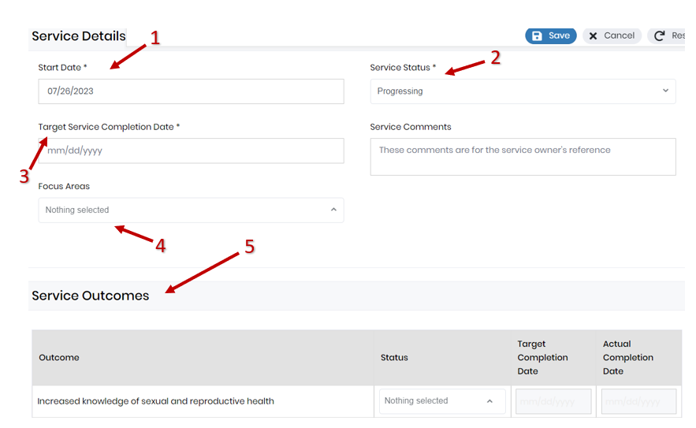

Slide 16
Exiting a Regular Service

Slide 17
Exiting a Regular Service
If a regular service was stopped before it could be completed, the service and the outcomes can be exited to indicate that the service was not completed.
In order to exit a regular service, you must select the following:
Service status must be set to “Exited”
Upon setting this status, you must enter an “Actual Service Completion Date” to indicate the date the service stopped being provided
Change any outcomes that will not be achieved from “Progressing” to “Exited”
When selecting the “Exited” outcome status, you must select an “Actual Date of Completion” to indicate the date the outcome was no longer progressing
Changing the outcomes status is not a required step if the outcomes have not been exited
If outcomes were achieved even if the service was exited, those outcomes can indicated by changing their status to “Achieved”

Slide 18
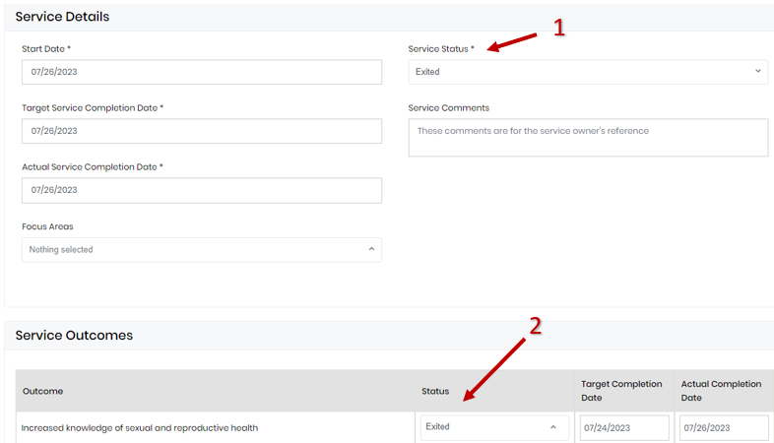

Slide 19
Completing a Regular Service

Slide 20
Completing a Regular Service
Once a regular service has reached successful completion or the outcome of the service was unsuccessful, you can update the service in order to indicate this.
In order to complete a regular service, the user must select the following:
Service status must be set to “Achieved”
Upon setting this status, you must enter an “Actual Service Completion Date” to indicate the date the service was completed
Change any outcomes that have been achieved from “Progressing” to “Achieved”
When selecting the “Achieved” outcome status, you must select an “Actual Date of Completion” to indicate the date the outcome was completed
Changing the outcomes status is not a required step if the outcomes have not yet been achieved
You have the ability to edit the outcomes of a service even after that service has been achieved
If outcomes were not completed even if the service was achieved, those outcomes can indicated by changing their status to “Exited”

Slide 21
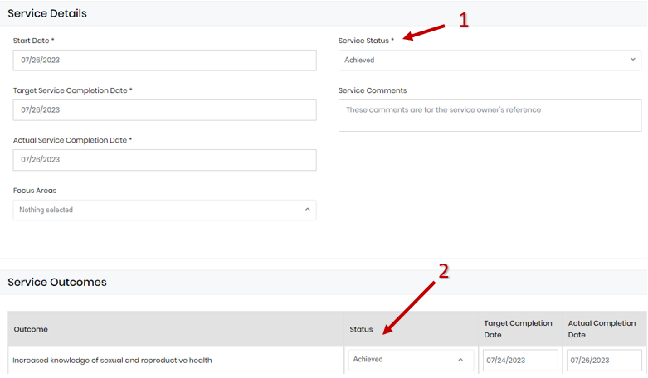

Slide 22
Service Maintenance

Slide 23
Service Maintenance (Edit/View Services)
Once a service has been added to a client’s action plan, your ability to edit and delete the service will depend on your permissions, the service type and the status of the service.
Once a service has been saved, there are specific fields across all service types that you will never be able to edit. These fields include:
Service/Service Variant
Program/Program Variant
Service Start Date
Below are other scenarios describing when a field will no longer be editable from the service screen:
Once an outcome has been saved as “Achieved”, it will no longer be editable from the service screen.
The actual date of completion will no longer be editable
If checked, the checkbox is unable to be deselected
Once an outcome has been saved as “Exited”, it will no longer be editable from the service screen.
The actual date of completion will no longer be editable

Slide 24
Program Enrollment vs Service Delivery
Depending on your program and program's workflow you may want to:
Enroll a Client in a Program without adding any Services
Enroll a Client in a Program and add multiple services
Add a One-Time Service without enrolling the client in a Program
Add Regular Service or Services without enrolling the client in a Program

Slide 25
Questions

