Slide 1
Referrals in CMS
MOC Inc

Slide 2
Agenda
Referral Best Practices
Creating a Referral in CMS
Managing a Received Referral

Slide 3
Sending Referrals in CMS

Slide 4
Referral Best Practices
For the program receiving the referral to be able to engage with the client constructively from the start, they need to have a basic understanding of the services being sought and what needs led to the referral.
Inform the client that you are making a referral for them and give them some specifics: program name, description of program, the name of someone from the program who might be contacting them, etc.
In the referral, provide a quick summary of the client’s needs.
Also in the referral, make specific suggestions about what services the program receiving the referral might be able to provide to the client (pending an eligibility screening).
If you aren't sure what Program to refer or how they can help you can review MOC's website for information about other programs available to your client --> www.mocinc.org

Slide 5
Creating the Referral in CMS
To create a new Referral click “Programs & Referrals” in the Client Detailed Record
“Add New Program Referral”
Choose the Program you are sending the referral to
Choose admin user you want to send the referral to
CMS automatically defaults to the admin who manages incoming referrals for the program you are sending the referral to
You can always change who the referral is sent to by changing the "Assign To" dropdown
Select the Referral Date which is today
Choose the Source (Generally your program or the program who is sending the referral)
Enter a comment
To reach the client in a timely way, the program receiving the referral needs to know the client’s name and their current contact information.
Referral Comment Best Practices:
Provide 2 pieces of contact info (e.g., cell & email) in case one changes, or a data entry error invalidates one
Note whether the contact information provided is for the client or someone who cares for the client (e.g., self vs. parent, guardian, adult child of a senior, etc.)
Note whether the staff person can leave a message and/or text
Note current services received and the status of the client record
When sending a referral always make sure there is contact information for the client in Client Details

Slide 6
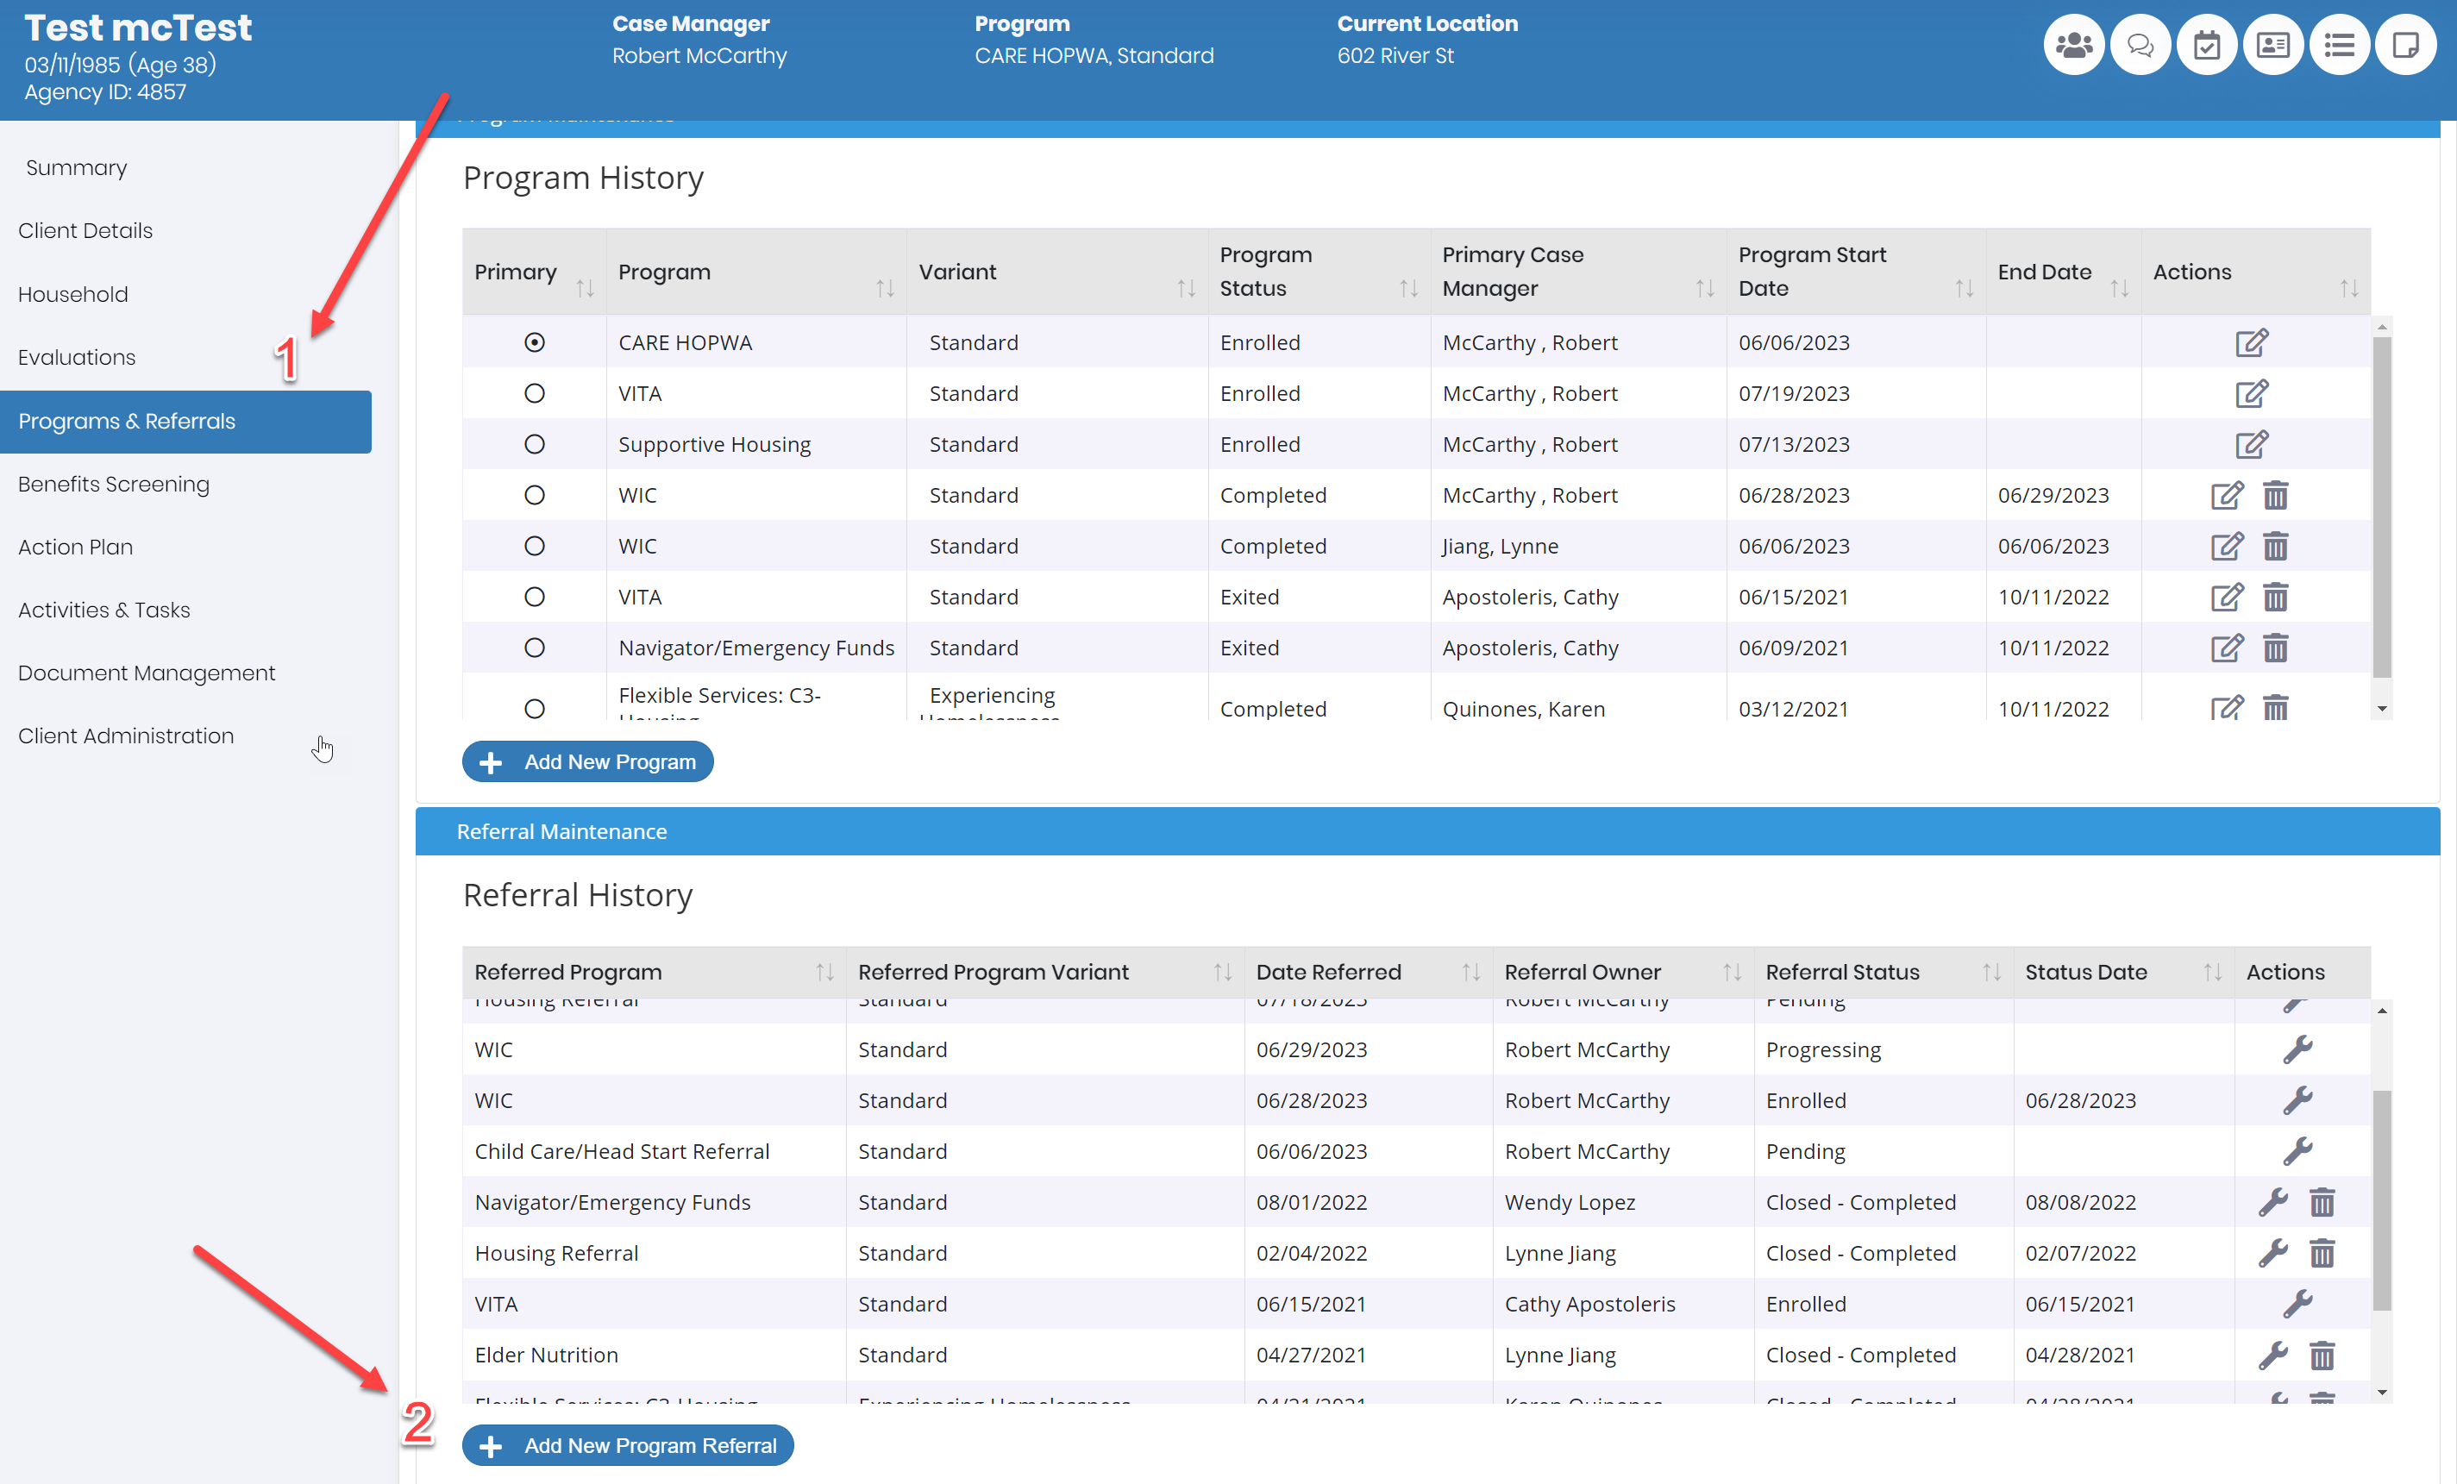

Slide 7
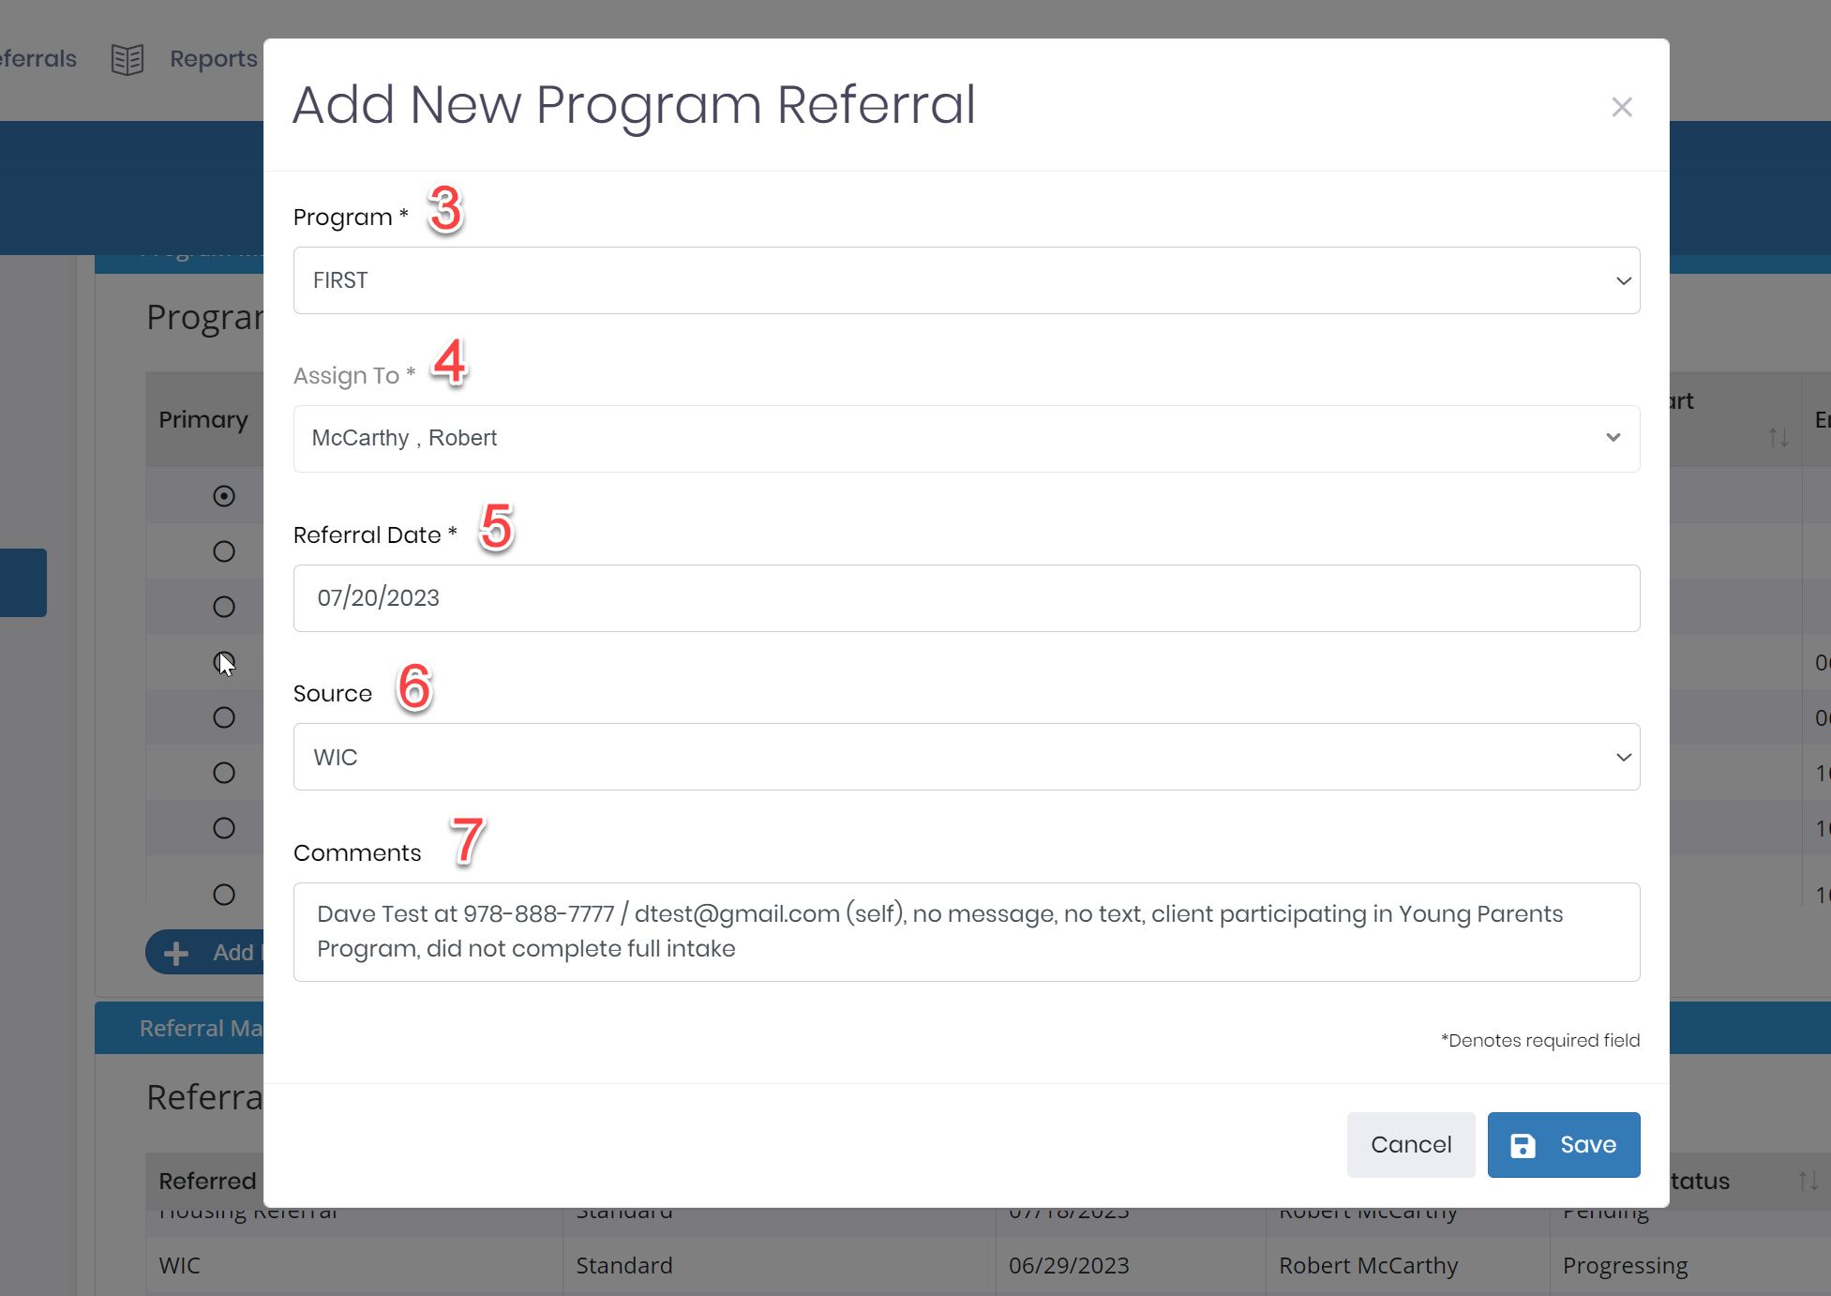

Slide 8
Full Comment Template
Client’s Name at contact info #1 / contact info #2 (self/other); ok to text (yes/no); ok to call (yes/no). Client record status. Client needs <<<insert>>>. Client has <<<insert services to date>>>. Client has been informed of referral.
Example 1: Dave Test at 978-888-7777 / dtest@gmail.com (self), no message, no text, client participating in Young Parents Program, did not complete full intake
Example 2: Frank Test at 978-888-7777 / jdoe@gmail.com (contact is father, John Doe), ok to leave message, ok to text, client participating in Young Parents Program, completed full intake and pre-assessment on father

Slide 9
Managing Referrals in CMS

Slide 10
Managing a Received Referral
In the Referral History table click the Manage button to the right of the referral in the "Actions" column
Click "Manage" button in the top right
Reassign a referral by changing the owner of the referral in the "Assign To" drop down
Change the Status of a referral with the Referral Status drop down
"Closed - Accepted" - Client automatically enrolled in the program
If you are activating a referral, you will be required to enter a Program Start Date.
Once all required fields are completed and you save the Activated referral, the client will now have a program record with a status of Active. From this point on, information about the client’s program will not be edited from the Referral Management screen. Rather, you will edit program information from the Edit Program screen within the Program screen of the client’s record.
"Closed - Completed" - Referral closed and client is not enrolled in the program
If the referral is being closed enter a Referral Closure Date

Slide 11
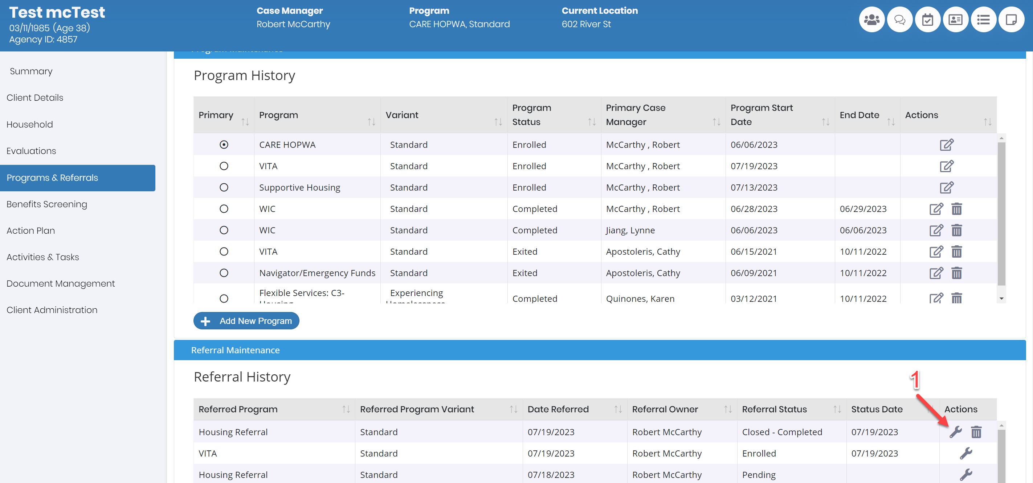

Slide 12
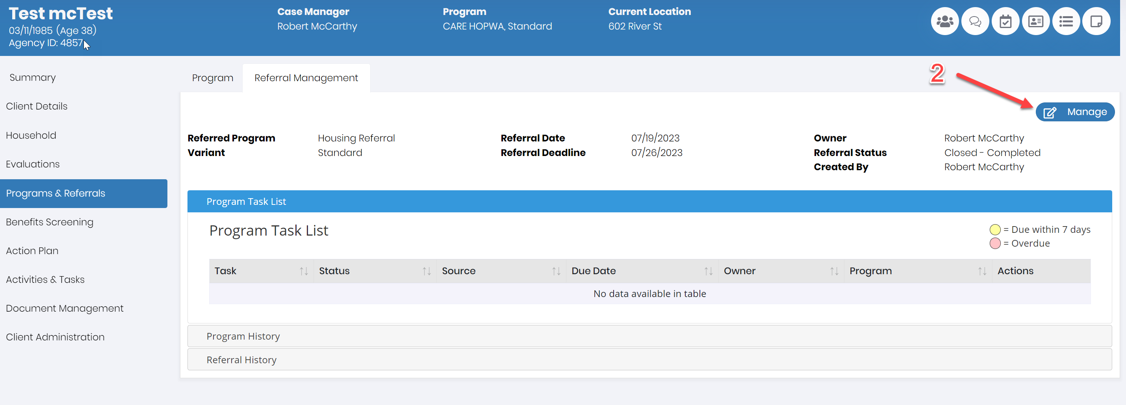

Slide 13
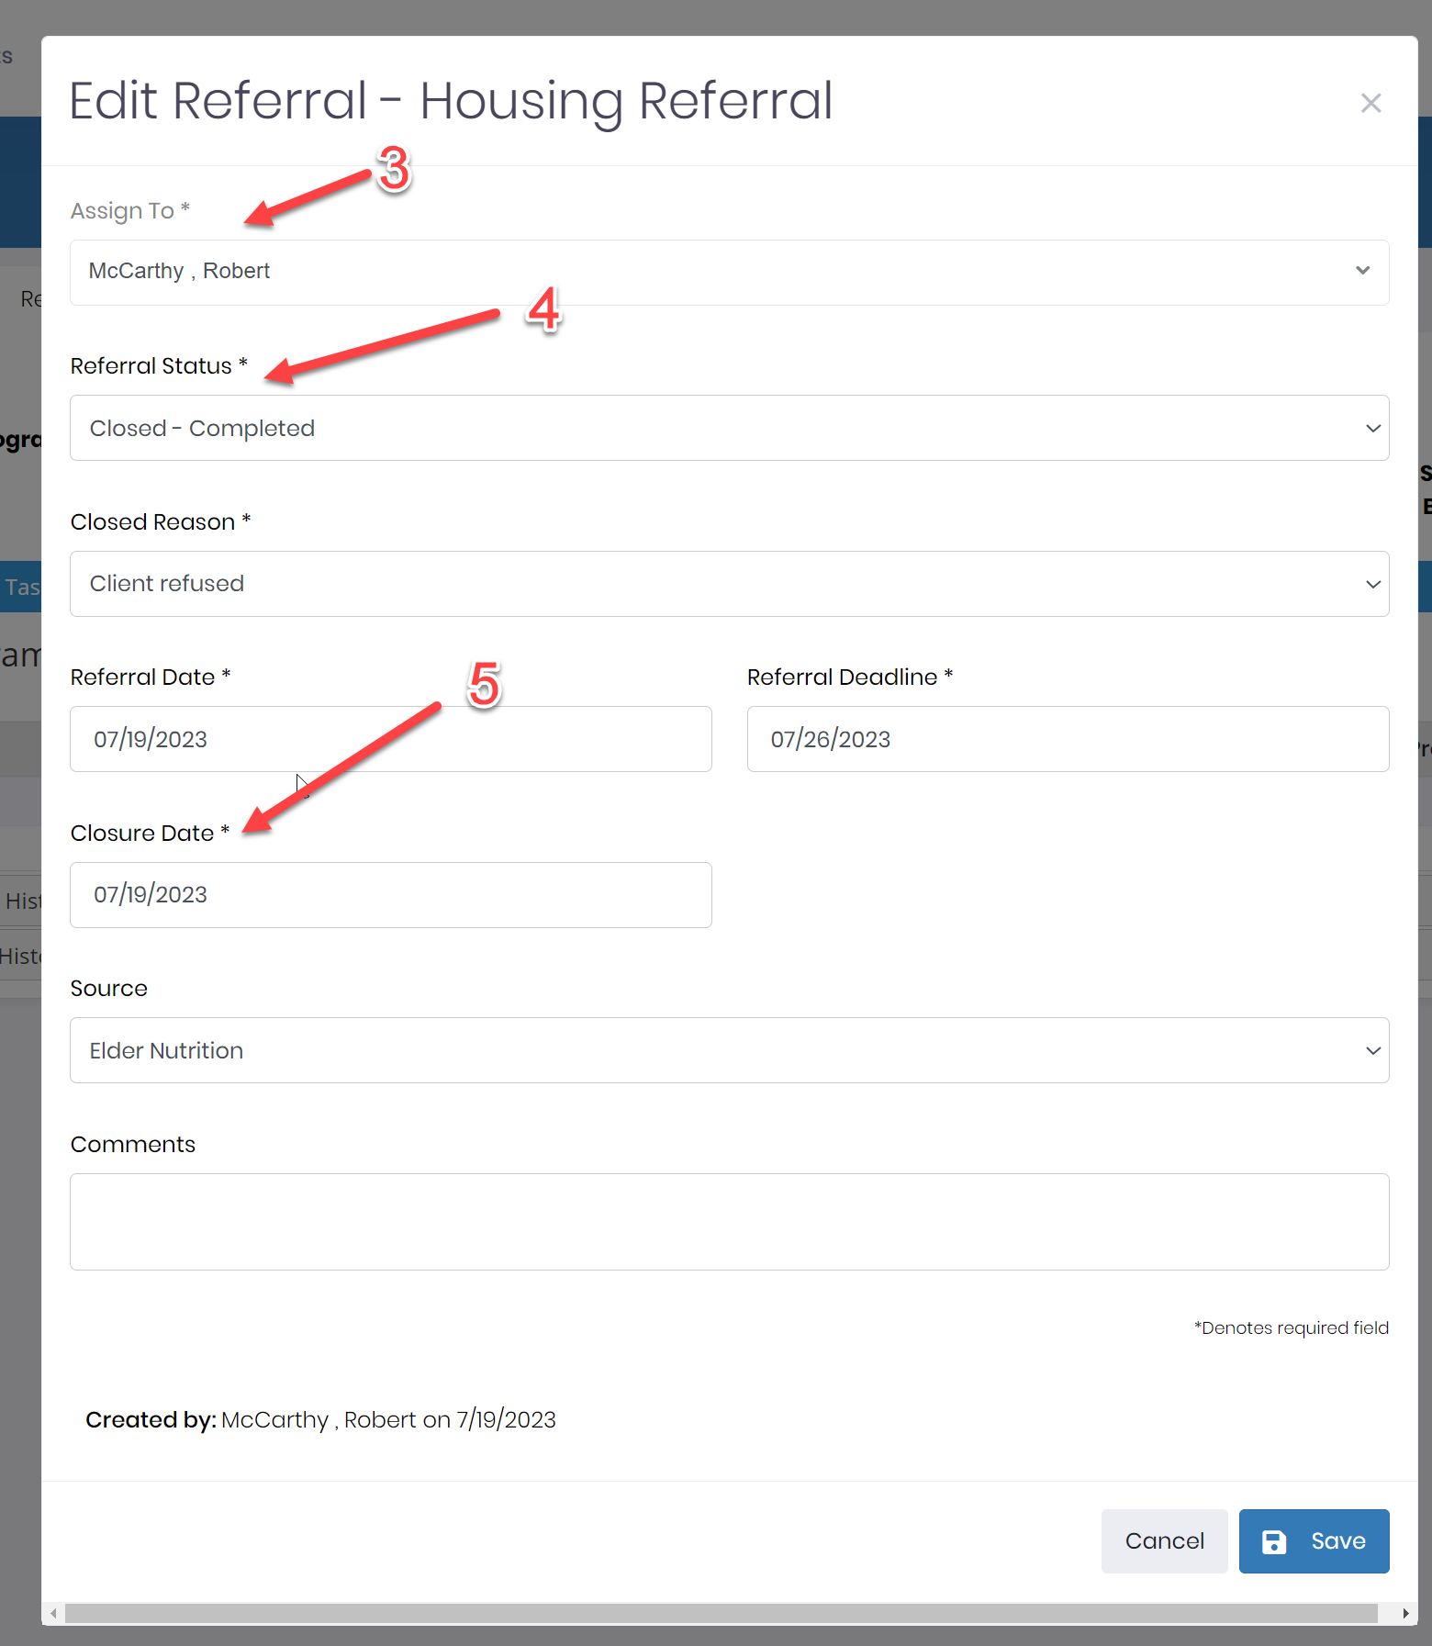

Slide 14
Questions

