Slide 1
Tasks & Activities in CMS
MOC Inc

Slide 2
Agenda
User Created Tasks
Creating a Task
System Generated Tasks
Viewing/Editing Tasks
Completing Tasks
Task Maintenance
Logging Activities

Slide 3
User Created Tasks

Slide 4
User-Created Tasks
Useful for setting reminders for yourself or other staff such as follow up with client on ____ date
Creating a Task:
To create a task click the Schedule a Task button in the client Record Header
In the Add Task window Assign To fields will be defaulted to the user adding the task, Program will be defaulted to the client’s selected primary program
After completing all required fields and saving, the task will be added to the client’s Task List on the summary as well as the assigned user’s Dashboard

Slide 6
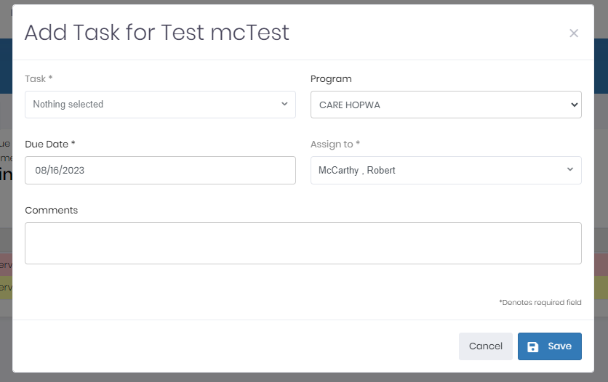

Slide 7
System Generated Tasks

Slide 8
System Generated Tasks
The system will generate a task for a service owner based on the service target completion date. This will remind the user to complete the task or follow up
When the user opens a regular service for a client and sets a target completion date for the service a task to complete a service is generated 7 days before the target completion date of the service.
Once the user completes the service in the Action Plan tab, the task will be removed and will appear in Activity/Task Maintenance.
A user is not able to complete a system generated task from within the task itself, this must be done via the Action Plan.

Slide 9
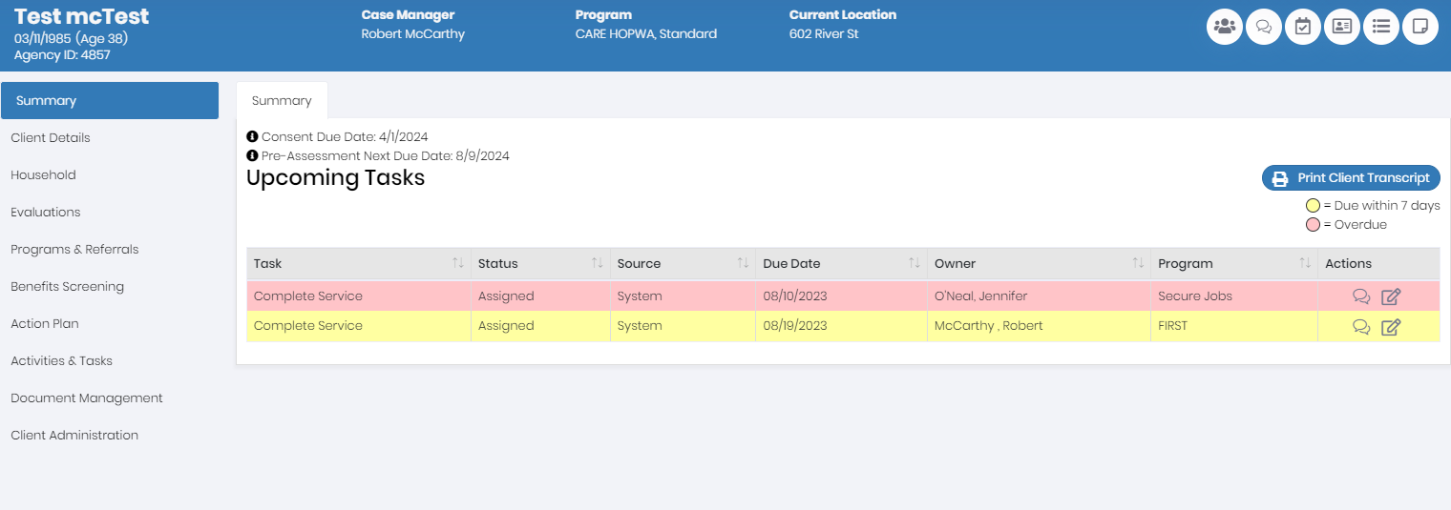

Slide 10
Viewing/Editing Tasks

Slide 11
Viewing/Editing Tasks
In order to view the details of or edit a task, click the View/Edit Task button within a row of the given Tasks table. This will open the View/Edit Task screen.
Task type and program are NOT editable once the task has been created if an error has occurred, the current task should be discontinued and a new task should be opened with the correct information
From the view/edit screen, you can edit the Due Date, Task Owner, and Task Status

Slide 12
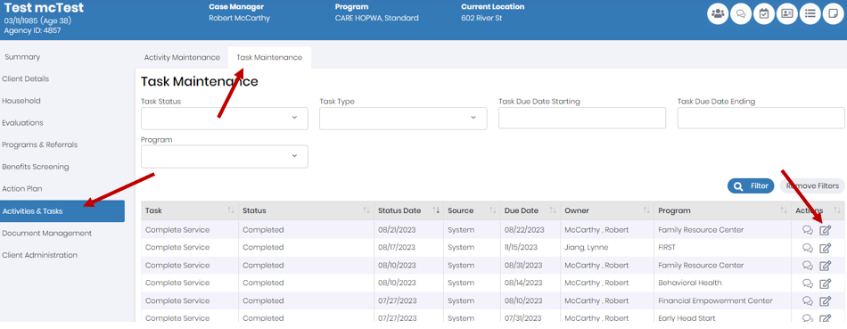

Slide 13
Viewing/Editing Tasks
A Task can be set to a few different statuses from the view/edit screen:
In Process- Task is currently in process by owner
Scheduled- Task has been scheduled by owner for a future owner
Discontinued- Task is no longer needed
When selecting the discontinued status- a discontinued reason is required
This will remove the task from all task dashboards
You can NOT mark a task as completed from this screen. In order to complete a task, an activity must be logged.
Once you make the desired changes and click the Save button to submit the changes. Please note that if you changed the Task Owner, then the task will be switched to that user’s task dashboard

Slide 14
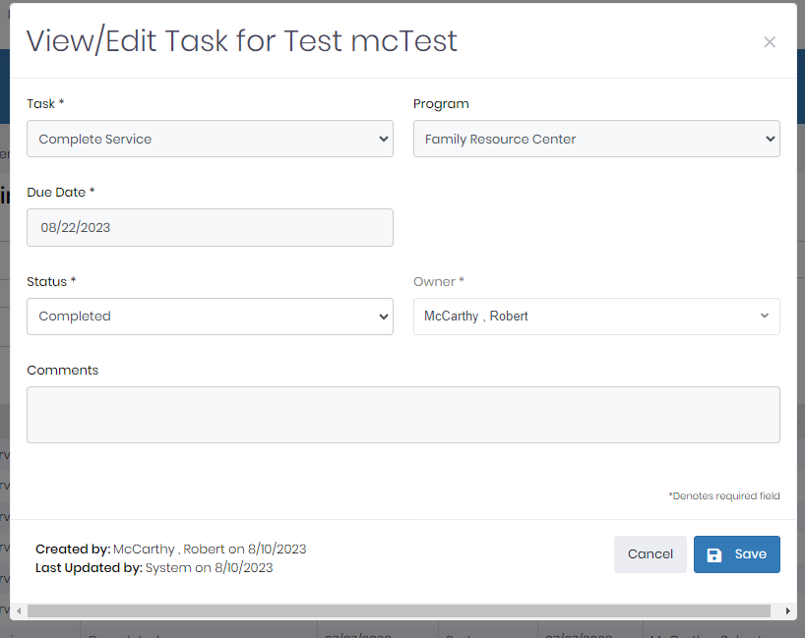

Slide 15
Completing Tasks

Slide 16
Completing Tasks
In order to "complete" a user generated task, an activity must be logged.
An activity can be logged via any task table found on various Task Dashboards or the Log Activity button located in the Client Record Header.
If you change the task status and Submit the activity, then the task’s status will change
From the activity log screen, the user can change enter in the necessary activity information and change the status of the task to “Completed”
Once submitted, the task will be removed from the client’s upcoming tasks table and from the user’s task dashboard. The task will then be logged with the activity in the Task Maintenance section of the client record

Slide 18
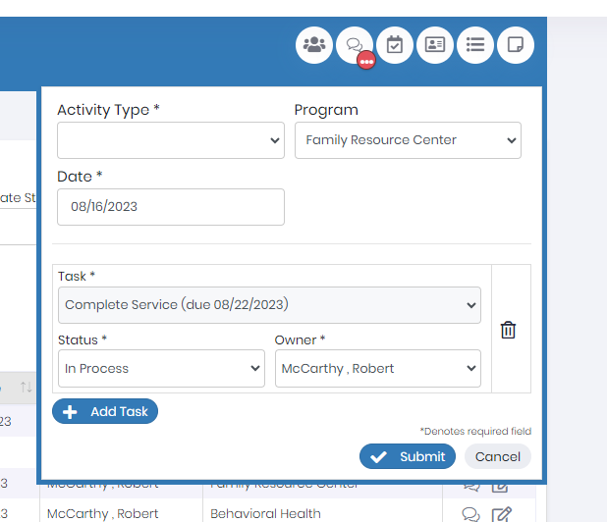

Slide 19
Task Maintenance

Slide 20
Task Maintenance
While all “open” tasks appear on the client’s Upcoming Tasks table, all Completed and Discontinued tasks will appear on the Task Maintenance screen.
The Task Maintenance screen is located within the Activity Maintenance section of the client record.
The typical user will have the ability to view completed and discontinued tasks from this screen. To view the details of a task, click the View icon in a row of the table, which will open up a read only version of the task details (this screen looks the same as the View/Edit task screen.)
Users with the permission will have the ability to edit completed and discontinued tasks. Please note that if you set the task status back to an “open” status (i.e. In Process or Scheduled,) then the task will reappear on the client’s Upcoming Tasks list and the assigned user’s Dashboard.
Users with the permission will also have the ability to add an activity to completed and discontinued tasks (i.e. if a task had been completed/discontinued but someone forgot to log an additional activity to the task.) Click the “Log Activity” button within a row of 58 | Page the Task Maintenance to open the Activity window. This will allow certain users to submit an activity to a Discontinued/Completed task.

Slide 21
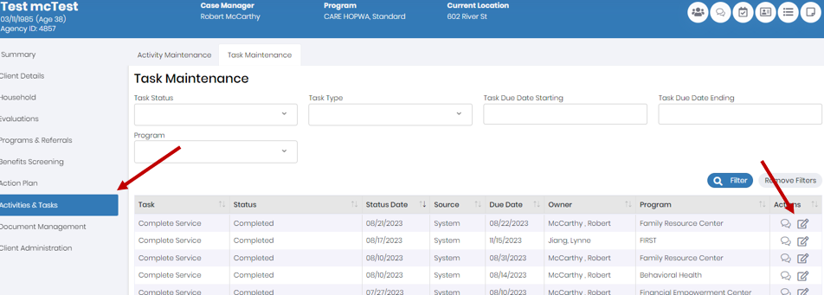

Slide 22
Activities

Slide 23
Activities
An activity is logged in order to track an interaction with or on behalf of a client.
You must log an activity in order to mark a task as complete. An activity can be logged via any task table found on various Task Dashboards or the Log Activity button located in the Client Record Header.
An activity can also be logged without an associated task from the Client Record Header.

Slide 24
Logging an Activity
The Log Activity window can be opened by clicking the “Log Activity” button located in the Client Record Header or the “Log Activity” button within a row of a Task table.
Based on the Activity Type that is selected, different fields will display on the Log Activity screen.
When opening a new activity without a task, the “Program” field will automatically default to the client’s primary program, but can be changed before submitting.

Slide 25
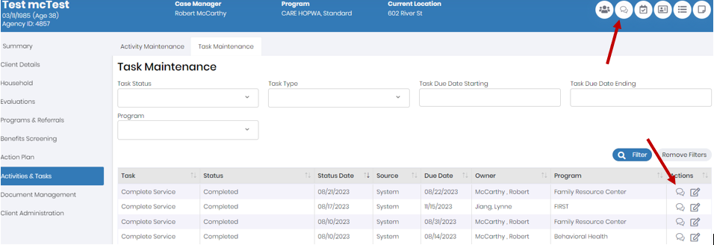

Slide 26
Logging an Activity
Activity With - If the Activity was with the client or someone else
Duration – the time (in minutes) it took to complete that activity
Clicking the “+Add Task” button will allow you to select from all of the client’s current tasks, and update a Tasks status based on the outcome of the Activity you are completing.
If you open the activity using the Log Activity button within a row of a Task table, then the associated task will automatically be open within the Log Activity screen.
multiple tasks can be “worked on” within a single activity. In other words, you can add multiple Tasks and update their statuses via one Activity record.

Slide 27
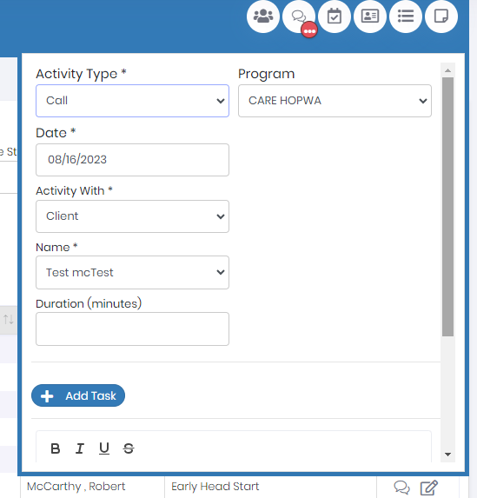

Slide 28
Questions

